Slide 1

CLASS 1 CD-404 INTRODUCTION TO DATA SCIENCE UNIT I
INTRODUCTION TO DATA SCIENCE
Prof. Vineeta Shrivastava
Assistant Professor
Department of Computer Science & Engineering
LNCT-E, Bhopal
Lakshmi Narain College of Technology Excellence, Bhopal

Slide 2
CLASS 1 CD-404 INTRODUCTION TO DATA SCIENCE UNIT I
AGENDA
What is Data?
Types of Data
What To Do With These Data?
Big Data and Challenges
Similarities between Big Data and Data Science
Difference between Big Data and Data Science
Prof. Vineeta Shrivastava
Assistant Professor
Department of Computer Science & Engineering
LNCT-E, Bhopal
Lakshmi Narain College of Technology Excellence, Bhopal

Slide 3



CLASS 1 CD-404 INTRODUCTION TO DATA SCIENCE UNIT I
Data
Lots of data is being collected and warehoused
Web data, e-commerce
Financial transactions, bank/credit transactions
Online trading and purchasing
Social Network
Prof. Vineeta Shrivastava
Assistant Professor
Department of Computer Science & Engineering
LNCT-E, Bhopal
Lakshmi Narain College of Technology Excellence, Bhopal

Slide 4
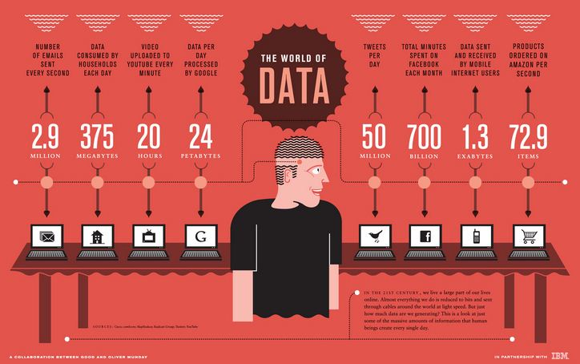
CLASS 1 CD-404 INTRODUCTION TO DATA SCIENCE UNIT I
How Much Data Do We have?
Google processes 20 PB a day
Facebook has 60 TB of daily logs
eBay has 6.5 PB of user data + 50 TB/day
Cost of 1 TB of disk: $35
Time to read 1 TB disk: 3 hrs
(100 MB/s)
Prof. Vineeta Shrivastava
Assistant Professor
Department of Computer Science & Engineering
LNCT-E, Bhopal
Lakshmi Narain College of Technology Excellence, Bhopal

Slide 5
CLASS 1 CD-404 INTRODUCTION TO DATA SCIENCE UNIT I
Data
In a general sense, "data" refers to raw facts, information, or observations that can be collected, stored, and processed.
Data can be in various forms, and it is the basic building block of information.
In the context of computing and technology, data is often represented in a structured format that can be manipulated and analyzed by computers.
Data can be processed and analyzed to extract meaningful insights, patterns, and trends.
In the context of data science and technology, the term "data" often refers to information that is stored and manipulated electronically, such as in databases, spreadsheets, or other digital formats.
This electronic data is crucial for various applications, including analytics, machine learning, and decision-making processes.
Prof. Vineeta Shrivastava
Assistant Professor
Department of Computer Science & Engineering
LNCT-E, Bhopal
Lakshmi Narain College of Technology Excellence, Bhopal

Slide 6
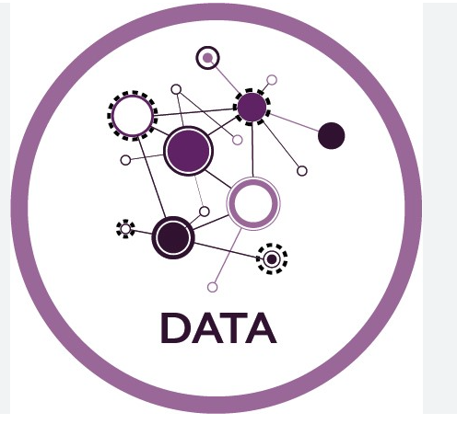
CLASS 1 CD-404 INTRODUCTION TO DATA SCIENCE UNIT I
Data
Data is a collection of information gathered by observations, measurements, research or analysis.
They may consist of facts, numbers, names, figures or even description of things.
Data is organized in the form of graphs, charts or tables.
Data refers to a systematic record of a specific quantity.
In other words, it is a set of facts and figures which are useful in a particular purpose like a survey or an analysis.
Prof. Vineeta Shrivastava
Assistant Professor
Department of Computer Science & Engineering
LNCT-E, Bhopal
Lakshmi Narain College of Technology Excellence, Bhopal

Slide 7
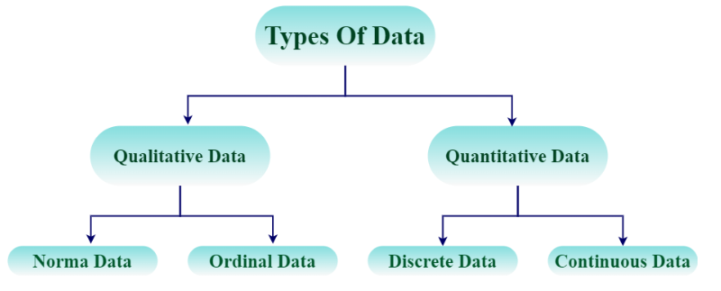
CLASS 1 CD-404 INTRODUCTION TO DATA SCIENCE UNIT I
Types of Data
Quantitative Data: Numerical information that can be measured and counted. Examples include height, weight, temperature, and income.
Qualitative Data: Descriptive, non-numeric information that is categorical in nature. Examples include colors, names, and types of fruits.
Prof. Vineeta Shrivastava
Assistant Professor
Department of Computer Science & Engineering
LNCT-E, Bhopal
Lakshmi Narain College of Technology Excellence, Bhopal

Slide 8
CLASS 1 CD-404 INTRODUCTION TO DATA SCIENCE UNIT I
Types of Data
Categorical Data: Represents categories or labels and is often used to group data. Examples include types of animals, genres of movies, or marital status.
Ordinal Data: Represents categories with a meaningful order or ranking. Examples include education levels (e.g., high school, college, postgraduate).
Nominal Data: Represents categories with no inherent order. Examples include colors or types of fruits.
Continuous Data: Can take any value within a given range. Examples include height, weight, and temperature.
Discrete Data: Consists of distinct values and cannot take on values between them. Examples include the number of students in a class or the number of cars in a parking lot.
Prof. Vineeta Shrivastava
Assistant Professor
Department of Computer Science & Engineering
LNCT-E, Bhopal
Lakshmi Narain College of Technology Excellence, Bhopal

Slide 9
CLASS 1 CD-404 INTRODUCTION TO DATA SCIENCE UNIT I
What To Do With These Data?
Aggregation and Statistics
Data warehousing and OLAP (online analytical processing)
Indexing, Searching, and Querying
Keyword based search
Pattern matching
Knowledge discovery
Data Mining
Statistical Modeling
Prof. Vineeta Shrivastava
Assistant Professor
Department of Computer Science & Engineering
LNCT-E, Bhopal
Lakshmi Narain College of Technology Excellence, Bhopal

Slide 10
CLASS 1 CD-404 INTRODUCTION TO DATA SCIENCE UNIT I
What is Data Science?
Data Science is a field or domain which includes and involves working with a huge amount of data and using it for building predictive and prescriptive analytical models.
It’s about capturing, (building the model) analysing (validating the model), and utilizing the data(deploying the best model). It is an intersection of Data and computing.
It is a blend of the field of Computer Science, Business, and Statistics together.
Prof. Vineeta Shrivastava
Assistant Professor
Department of Computer Science & Engineering
LNCT-E, Bhopal
Lakshmi Narain College of Technology Excellence, Bhopal

Slide 11
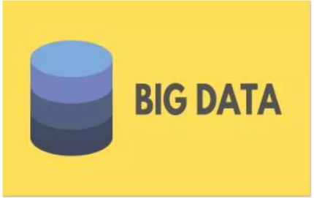
CLASS 1 CD-404 INTRODUCTION TO DATA SCIENCE UNIT I
Big Data
Big data refers to huge amount of data that cannot be stored and processed using traditional computing approaches with a given time frame.
Prof. Vineeta Shrivastava
Assistant Professor
Department of Computer Science & Engineering
LNCT-E, Bhopal
Lakshmi Narain College of Technology Excellence, Bhopal

Slide 12
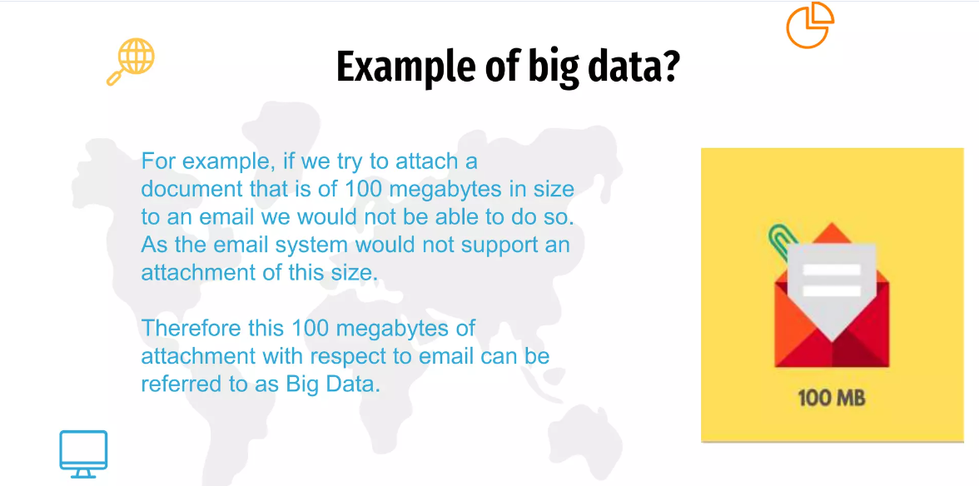
CLASS 1 CD-404 INTRODUCTION TO DATA SCIENCE UNIT I
Big Data
Prof. Vineeta Shrivastava
Assistant Professor
Department of Computer Science & Engineering
LNCT-E, Bhopal
Lakshmi Narain College of Technology Excellence, Bhopal

Slide 13
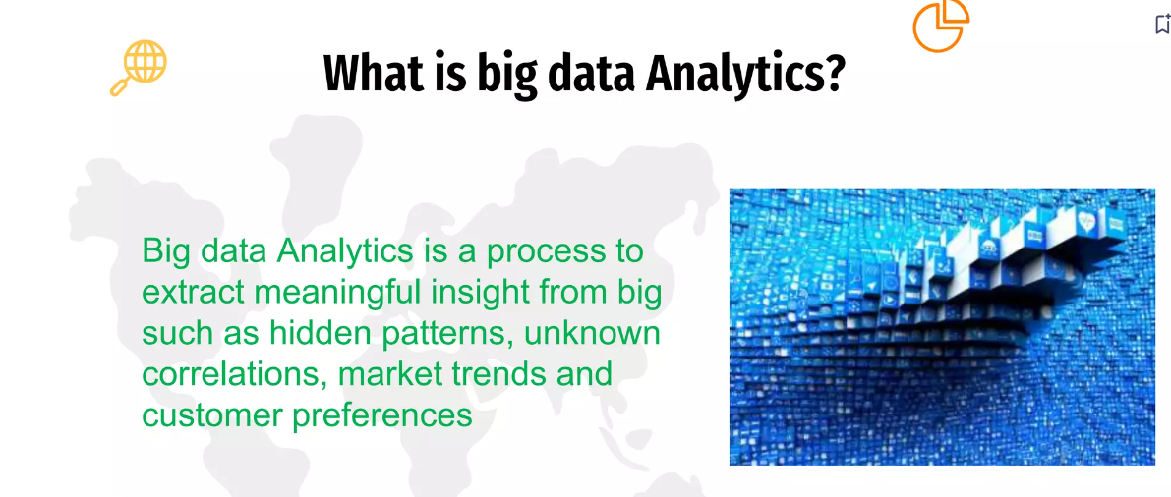
CLASS 1 CD-404 INTRODUCTION TO DATA SCIENCE UNIT I
Big Data
Prof. Vineeta Shrivastava
Assistant Professor
Department of Computer Science & Engineering
LNCT-E, Bhopal
Lakshmi Narain College of Technology Excellence, Bhopal

Slide 14
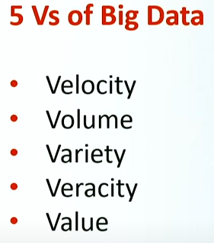
CLASS 1 CD-404 INTRODUCTION TO DATA SCIENCE UNIT I
Characteristics Big Data
Prof. Vineeta Shrivastava
Assistant Professor
Department of Computer Science & Engineering
LNCT-E, Bhopal
Lakshmi Narain College of Technology Excellence, Bhopal

Slide 15
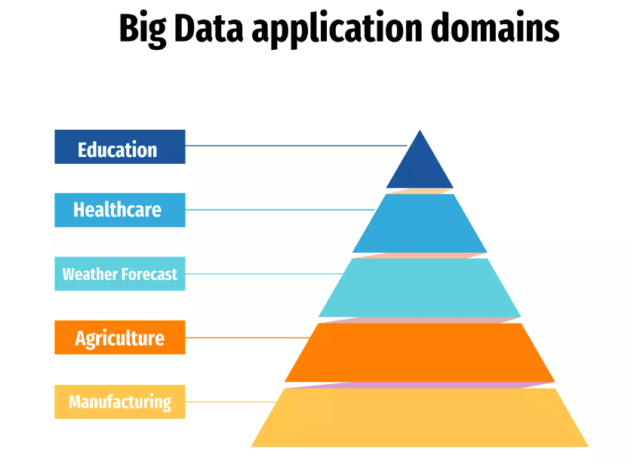
CLASS 1 CD-404 INTRODUCTION TO DATA SCIENCE UNIT I
Prof. Vineeta Shrivastava
Assistant Professor
Department of Computer Science & Engineering
LNCT-E, Bhopal
Lakshmi Narain College of Technology Excellence, Bhopal

Slide 16
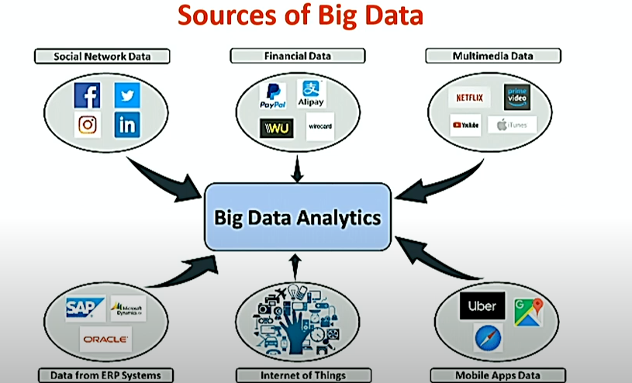
CLASS 1 CD-404 INTRODUCTION TO DATA SCIENCE UNIT I
Sources Big Data
Prof. Vineeta Shrivastava
Assistant Professor
Department of Computer Science & Engineering
LNCT-E, Bhopal
Lakshmi Narain College of Technology Excellence, Bhopal

Slide 17
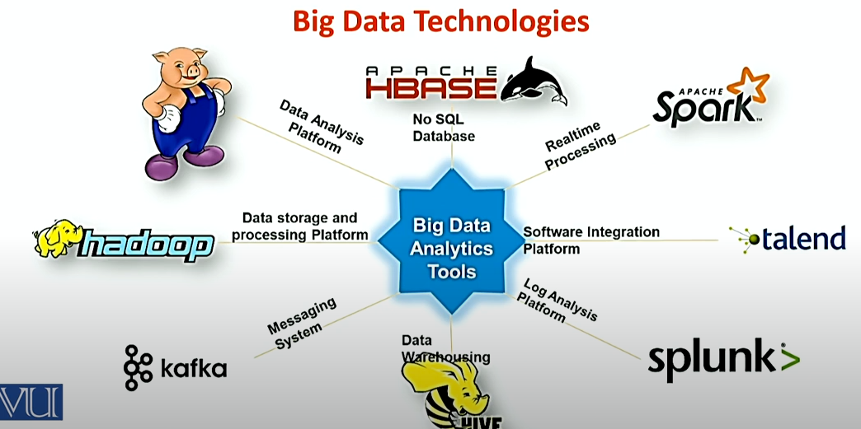
CLASS 1 CD-404 INTRODUCTION TO DATA SCIENCE UNIT I
Big data Technologies
Prof. Vineeta Shrivastava
Assistant Professor
Department of Computer Science & Engineering
LNCT-E, Bhopal
Lakshmi Narain College of Technology Excellence, Bhopal

Slide 18
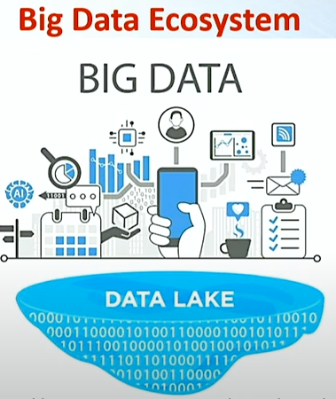
CLASS 1 CD-404 INTRODUCTION TO DATA SCIENCE UNIT I
Data Lake
A data lake is a centralized repository designed to store, process, and secure large amounts of structured, semistructured, and unstructured data.
It can store data in its specific format and process any variety of it, ignoring size limits.
Prof. Vineeta Shrivastava
Assistant Professor
Department of Computer Science & Engineering
LNCT-E, Bhopal
Lakshmi Narain College of Technology Excellence, Bhopal

Slide 19
CLASS 1 CD-404 INTRODUCTION TO DATA SCIENCE UNIT I
Big Data and its Challenges
It is huge, large, or voluminous data, information, or the relevant statistics acquired by large organizations. Many software and data storages is created and prepared as it is difficult to compute the big data manually. It is used to discover patterns and trends and make decisions related to human behavior and interaction technology.
Challenges
Requires specialized skills and expertise in data engineering, data management, and big data tools and technologies
Can be expensive to implement and maintain due to the need for specialized infrastructure and software
May face privacy and security concerns when handling sensitive data
Can be challenging to integrate with existing systems and processes
Prof. Vineeta Shrivastava
Assistant Professor
Department of Computer Science & Engineering
LNCT-E, Bhopal
Lakshmi Narain College of Technology Excellence, Bhopal

Slide 20
CLASS 1 CD-404 INTRODUCTION TO DATA SCIENCE UNIT I
Similarities between Big Data and Data Science
Both fields deal with large amounts of data and require specialized skills and expertise
Both aim to extract insights and knowledge from data to inform decision-making
Both have a wide range of applications in various industries
Both can lead to significant cost savings and operational efficiencies when applied correctly
Prof. Vineeta Shrivastava
Assistant Professor
Department of Computer Science & Engineering
LNCT-E, Bhopal
Lakshmi Narain College of Technology Excellence, Bhopal

Slide 21
CLASS 1 CD-404 INTRODUCTION TO DATA SCIENCE UNIT I
Differences between Big Data and Data Science
Data Science | Big Data
Data Science is an area. | Big Data is a technique to collect, maintain and process huge information.
It is about the collection, processing, analyzing, and utilizing of data in various operations. It is more conceptual. | It is about extracting vital and valuable information from a huge amount of data.
It is a field of study just like Computer Science, Applied Statistics, or Applied Mathematics. | It is a technique for tracking and discovering trends in complex data sets.
The goal is to build data-dominant products for a venture. | The goal is to make data more vital and usable i.e. by extracting only important information from the huge data within existing traditional aspects.
Tools mainly used in Data Science include SAS, R, Python, etc | Tools mostly used in Big Data include Hadoop, Spark, Flink, etc.
It is a superset of Big Data as data science consists of Data scrapping, cleaning, visualization, statistics, and many more techniques. | It is a sub-set of Data Science as mining activities which is in a pipeline of Data science.
It is mainly used for scientific purposes. | It is mainly used for business purposes and customer satisfaction.
Prof. Vineeta Shrivastava
Assistant Professor
Department of Computer Science & Engineering
LNCT-E, Bhopal
Lakshmi Narain College of Technology Excellence, Bhopal

Slide 22
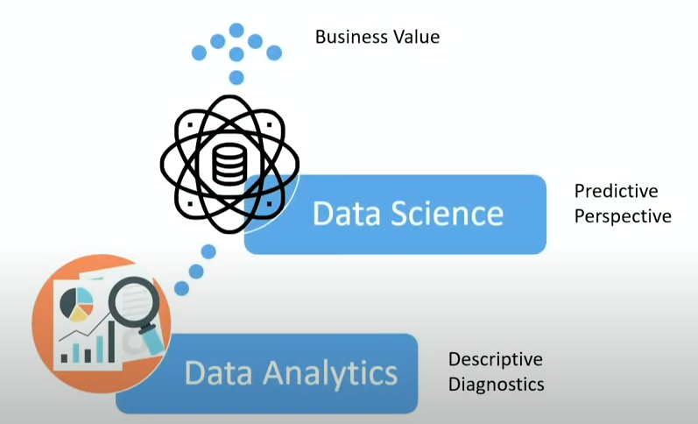
CLASS 1 CD-404 INTRODUCTION TO DATA SCIENCE UNIT I
Data Analyst vs Data Scientist
Prof. Vineeta Shrivastava
Assistant Professor
Department of Computer Science & Engineering
LNCT-E, Bhopal
Lakshmi Narain College of Technology Excellence, Bhopal

Slide 23
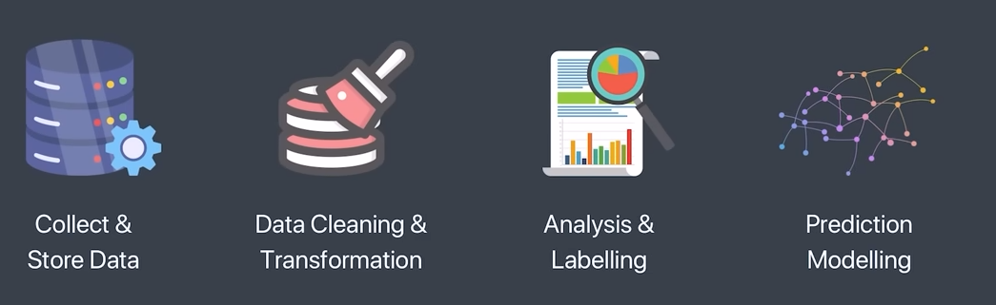
CLASS 1 CD-404 INTRODUCTION TO DATA SCIENCE UNIT I
Data Analyst vs Data Scientist
Prof. Vineeta Shrivastava
Assistant Professor
Department of Computer Science & Engineering
LNCT-E, Bhopal
Lakshmi Narain College of Technology Excellence, Bhopal

Slide 24
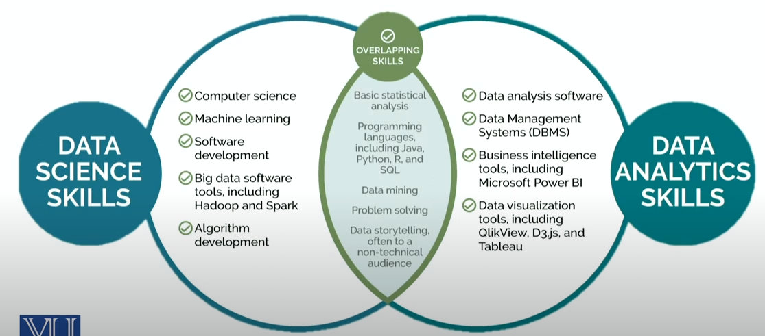
CLASS 1 CD-404 INTRODUCTION TO DATA SCIENCE UNIT I
Data Analyst vs Data Scientist
Prof. Vineeta Shrivastava
Assistant Professor
Department of Computer Science & Engineering
LNCT-E, Bhopal
Lakshmi Narain College of Technology Excellence, Bhopal

Slide 25

CLASS 1 CD-404 INTRODUCTION TO DATA SCIENCE UNIT I
Data Analyst vs Data Scientist
Data Scientist
Designing and development of new processes for data modelling and production using prototypes, algorithms, predictive models and custom analysis.
Prof. Vineeta Shrivastava
Assistant Professor
Department of Computer Science & Engineering
LNCT-E, Bhopal
Lakshmi Narain College of Technology Excellence, Bhopal

Slide 26
CLASS 1 CD-404 INTRODUCTION TO DATA SCIENCE UNIT I
Data Analyst vs Data Scientist
Use Case data scientist:
Apply deep learning techniques to process extensive clinical and laboratory reports to conduct a quicker and more precise diagnosis.
Detect early signs of an issue and enable the doctors to provide preventive care and better treatment to the patients.
Prof. Vineeta Shrivastava
Assistant Professor
Department of Computer Science & Engineering
LNCT-E, Bhopal
Lakshmi Narain College of Technology Excellence, Bhopal

Slide 27
CLASS 1 CD-404 INTRODUCTION TO DATA SCIENCE UNIT I
Data Analyst vs Data Scientist
Role of data Analyst
Examine large datasets to identify trends,develop charts, and create visual presentations to help bussiness make more strategic decisions.
Prof. Vineeta Shrivastava
Assistant Professor
Department of Computer Science & Engineering
LNCT-E, Bhopal
Lakshmi Narain College of Technology Excellence, Bhopal

Slide 28
CLASS 1 CD-404 INTRODUCTION TO DATA SCIENCE UNIT I
Data Analyst vs Data Scientist
Data Analysis use case:
Electronic Health Records
EHRs track and record patient’s health data like pre-existing conditions, allergies and treatments.
Sharing patients data between healthcare reduces duplication and improve patient care
Detect early signs of an issue or disease.
Prof. Vineeta Shrivastava
Assistant Professor
Department of Computer Science & Engineering
LNCT-E, Bhopal
Lakshmi Narain College of Technology Excellence, Bhopal

Slide 29
CLASS 1 CD-404 INTRODUCTION TO DATA SCIENCE UNIT I
Data Analyst vs Data Engineer vs Data Scientist
Data Analyst | Data Engineer | Data Scientist
Data Analyst analyses numeric data and uses it to help companies make better decisions. | Data Engineer involves in preparing data. They develop, constructs, tests & maintain complete architecture. | A data scientist analyses and interpret complex data. They are data wranglers who organize (big) data.
Prof. Vineeta Shrivastava
Assistant Professor
Department of Computer Science & Engineering
LNCT-E, Bhopal
Lakshmi Narain College of Technology Excellence, Bhopal

Slide 30
CLASS 1 CD-404 INTRODUCTION TO DATA SCIENCE UNIT I
Data Analyst vs Data Engineer vs Data Scientist (skills)
Data Analyst | Data Engineer | Data Scientist
Data Warehousing | Data Warehousing & ETL(extract transform load) | Statistical & Analytical skills
Adobe & Google Analytics | Advanced programming knowledge | Data Mining
Programming knowledge | Hadoop-based Analytics | Machine Learning & Deep learning principles
Scripting & Statistical skills | In-depth knowledge of SQL/ database | In-depth programming knowledge (SAS/R/ Python coding)
Reporting & data visualization | Data architecture & pipelining | Hadoop-based analytics
SQL/ database knowledge | Machine learning concept knowledge | Data optimization
Spread-Sheet knowledge | Scripting, reporting & data visualization | Decision making and soft skills
Prof. Vineeta Shrivastava
Assistant Professor
Department of Computer Science & Engineering
LNCT-E, Bhopal
Lakshmi Narain College of Technology Excellence, Bhopal

Slide 31
CLASS 1 CD-404 INTRODUCTION TO DATA SCIENCE UNIT I
Data Analyst vs Data Engineer vs Data Scientist (Roles And Responsibilities)
Data Analyst | Data Engineer | Data Scientist
Pre-processing and data gathering | Develop, test & maintain architectures | Responsible for developing Operational Models
Emphasis on representing data via reporting and visualization | Understand programming and its complexity | Carry out data analytics and optimization using machine learning & deep learning
Responsible for statistical analysis & data interpretation | Deploy ML & statistical models | Involved in strategic planning for data analytics
Ensures data acquisition & maintenance | Building pipelines for various ETL operations | Integrate data & perform ad-hoc analysis
Optimize Statistical Efficiency & Quality | Ensures data accuracy and flexibility | Fill in the gap between the stakeholders and customer
Prof. Vineeta Shrivastava
Assistant Professor
Department of Computer Science & Engineering
LNCT-E, Bhopal
Lakshmi Narain College of Technology Excellence, Bhopal

Slide 32
CLASS 1 CD-404 INTRODUCTION TO DATA SCIENCE UNIT I
DATAFICATION
Datafication is the transformation of social actions into online quantified data, thus allowing:
Real-time tracking
Data monitoring
Predictive Analysis and optimization
Prof. Vineeta Shrivastava
Assistant Professor
Department of Computer Science & Engineering
LNCT-E, Bhopal
Lakshmi Narain College of Technology Excellence, Bhopal

Slide 33
CLASS 1 CD-404 INTRODUCTION TO DATA SCIENCE UNIT I
DATAFICATION
Data Driven Organization:
Collective tools, technologies and processes used to transform an organization to a data-driven enterprise.
Defining the key to core business operations through a global reliance on data and its related infrastructure.
Prof. Vineeta Shrivastava
Assistant Professor
Department of Computer Science & Engineering
LNCT-E, Bhopal
Lakshmi Narain College of Technology Excellence, Bhopal

Slide 34
CLASS 1 CD-404 INTRODUCTION TO DATA SCIENCE UNIT I
DATAFICATION
Social Media & Datafication
Social Media apps usage is playing a great role in datafication:
Locations visited
Type of device used
Type of media viewed
Interactions with people
Prof. Vineeta Shrivastava
Assistant Professor
Department of Computer Science & Engineering
LNCT-E, Bhopal
Lakshmi Narain College of Technology Excellence, Bhopal

Slide 35
CLASS 1 CD-404 INTRODUCTION TO DATA SCIENCE UNIT I
DATAFICATION
Datafication Based Services
Datafication is so powerful that it can be used for a nearly infinite number of purposes across a multiple of industries
Google Maps
Location Based Services
Recommendation Engine
Prof. Vineeta Shrivastava
Assistant Professor
Department of Computer Science & Engineering
LNCT-E, Bhopal
Lakshmi Narain College of Technology Excellence, Bhopal

Slide 36
CLASS 1 CD-404 INTRODUCTION TO DATA SCIENCE UNIT I
THANKYOU
Prof. Vineeta Shrivastava
Assistant Professor
Department of Computer Science & Engineering
LNCT-E, Bhopal
Lakshmi Narain College of Technology Excellence, Bhopal

